Slide 1
The OSI Stack
Ubun-tutti-fruti
Shamim, Micha, Tim, Jeroen

Slide 2
Presentation Topics
What is OSI?
Why use OSI?
Each layer explained
Comparison to TCP/IP

Slide 3
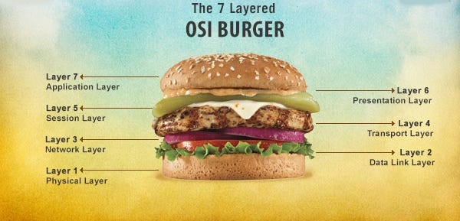
Created by the ISO
7 layers
OSI is a theoretical framework
TCP/IP is a practical framework

Slide 4
Why use OSI?
Detailed theoretical framework
Designing network architecture
Identifying security concerns
Troubleshooting

Slide 5
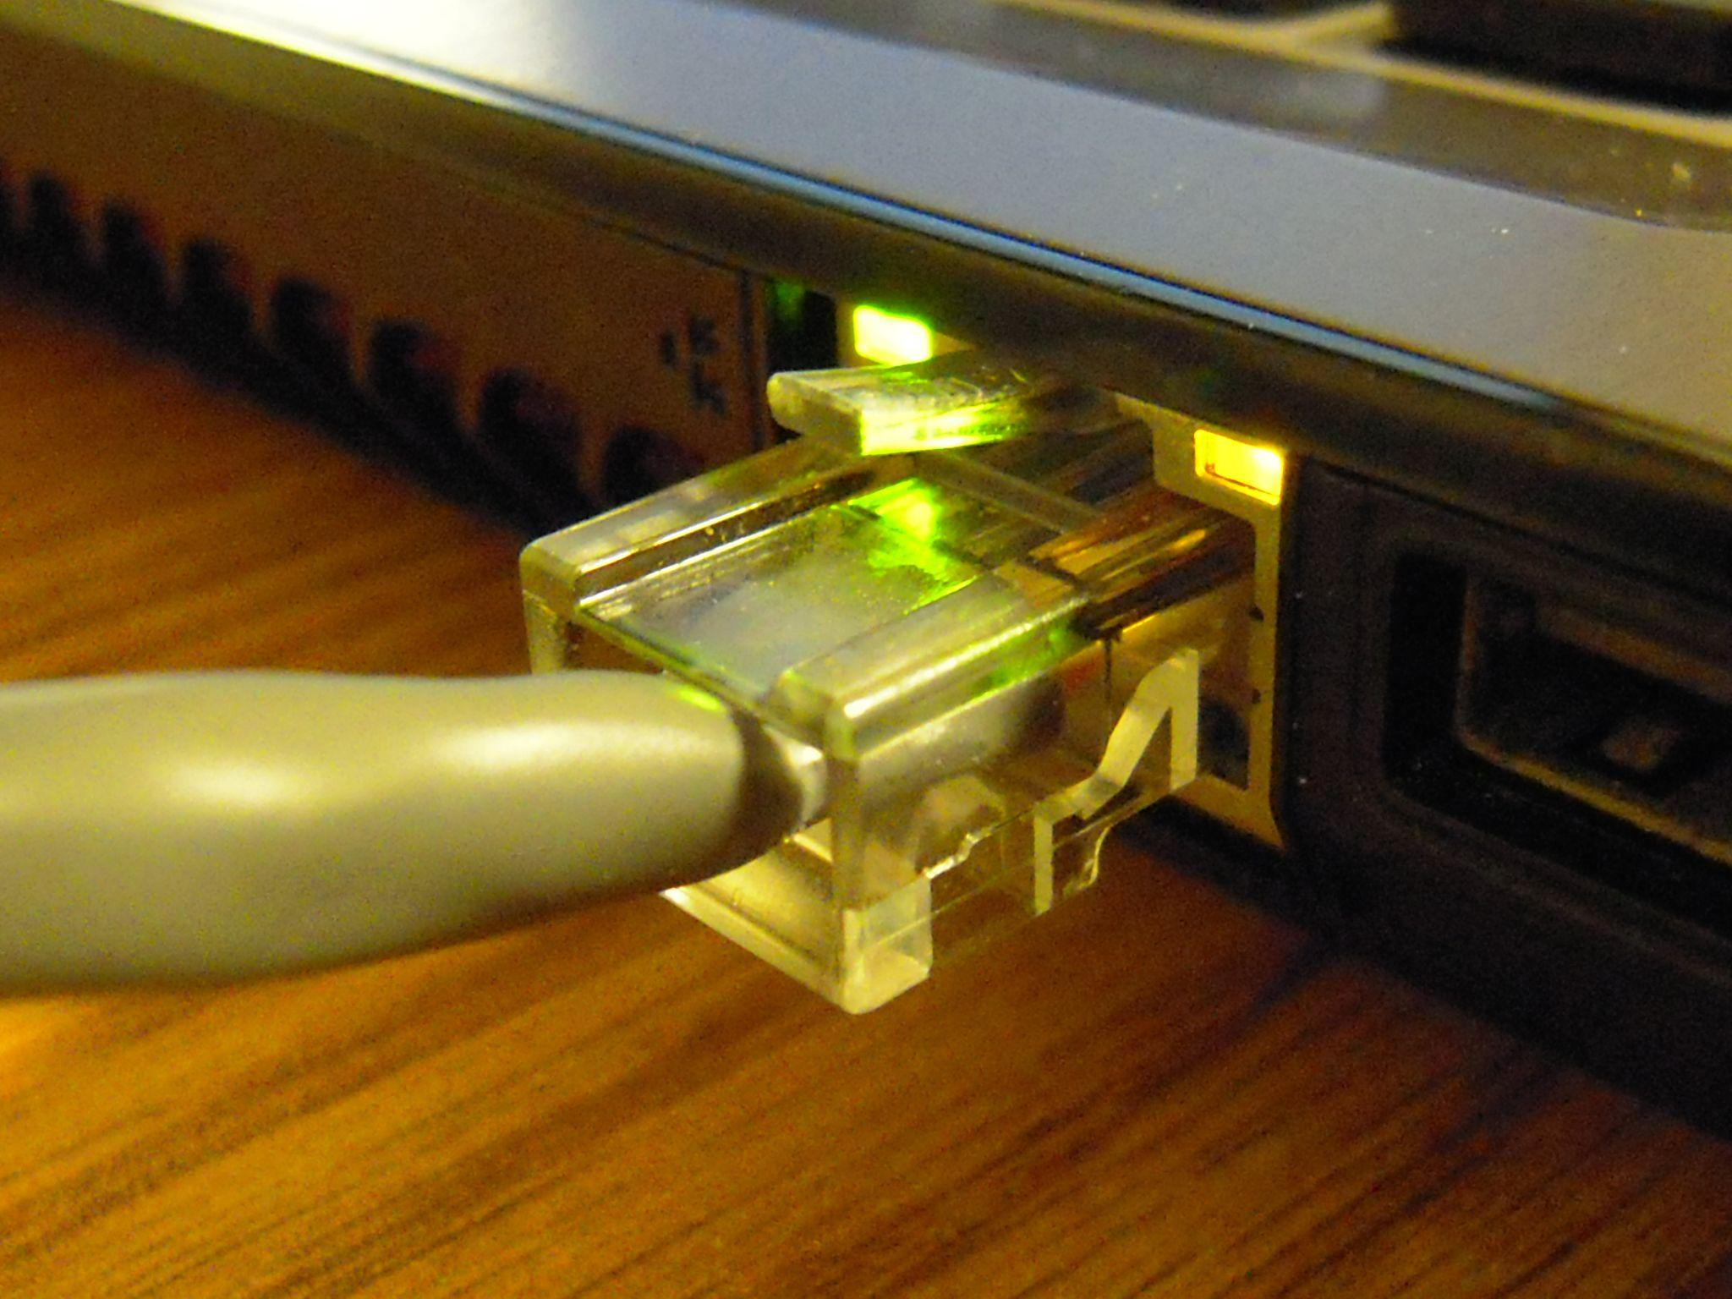
1: Physical layer
Layer one
Physical connections
Wiring, signalling
Bit as PDU

Slide 6
2: Data–Link Layer
Layer two
Reliable data transfer
Error detection and –correction
Access to physical medium.
PDU is Frame

Slide 7

3: Network Layer
Layer three
IP protocol
Routing
Packets as PDU
Routers

Slide 8
4: Transport Layer
Layer 4
End-to-end communication over the network
UDP and TCP

Slide 9
5: Session
Layer 5
Is responsible for establishing communication sessions between applications running on different network devices

Slide 10
6: Presentation
Layer six
Prepares data into a usable format.
Encryption, formatting, compression.

Slide 11
7: Application
Layer 7.
Forms the interface between the user and the systems’ resources.
Contains most of the protocols.
Notes:
Note: protocollen worden door ander team besproken.

Slide 12
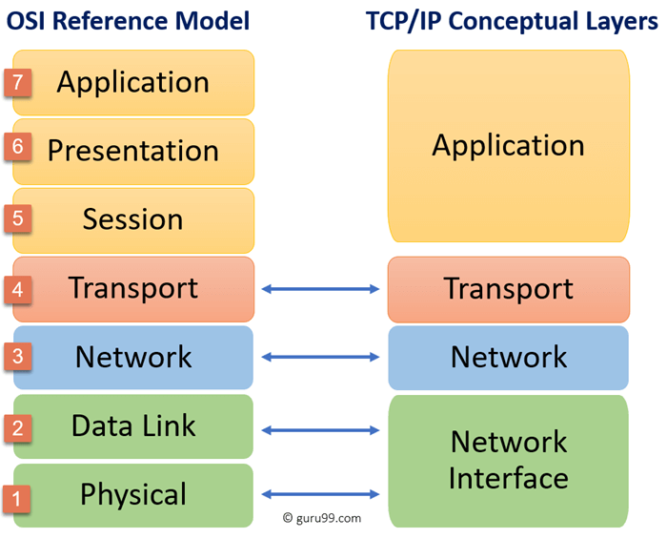
OSI vs TCP/IP

